Slide 1

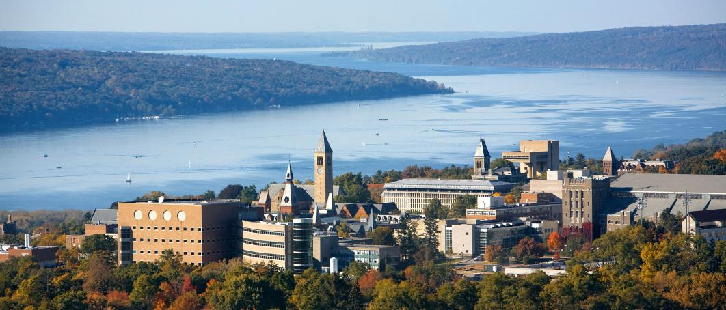
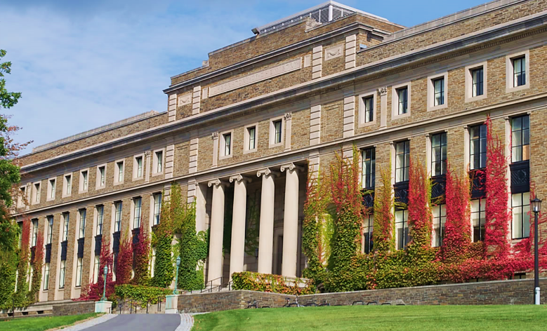
Quantum Nonadiabatic Dynamics from Classical Trajectories
Nandini Ananth
MOLSSI 2018

Slide 2
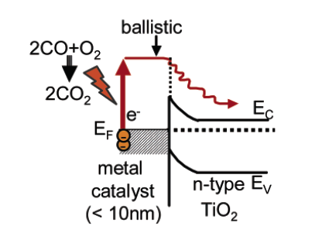

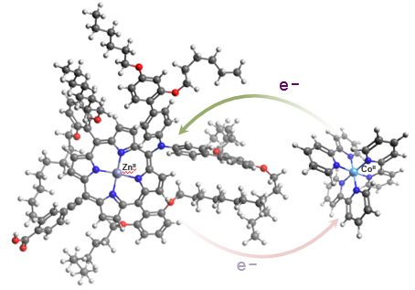

Charge and Energy Transfer Reactions
Mechanisms of singlet fission
$${S_{0}S}_{1}↔{\left[TT\right]}^{1}$$
Hot electron at metal surfaces
(Nienhaus, 2002; Somorjai 2006, Wodtke 2002)
T. Zeng, R. Hoffmann, and N. Ananth, J. Am. Chem. Soc. (2014)
T. Zeng, N. Ananth, and R. Hoffmann,
J. Am. Chem. Soc. (2014)
Redox process in dye-sensitized solar cell
(Gratzel, 2011)
E. G. Fuemmeler, N. Ananth et al, ACS Cent. Sci. (2016)
In collaboration with
Luis M. Campos, Columbia Univ.
X. Y. Zhu, Columbia Univ.
M. Sfeir, BNL
Coupled motions across different timescales and lengthscales
Important quantum effects: Tunneling, Zero-Point Energy, Coupled electron-nuclear dynamics, Coherences…
R. L. Kenion and N. Ananth, Phys. Chem. Chem. Phys. (2016)

Slide 3

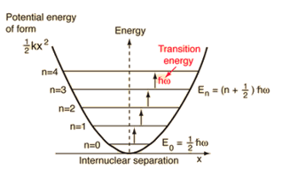
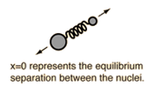
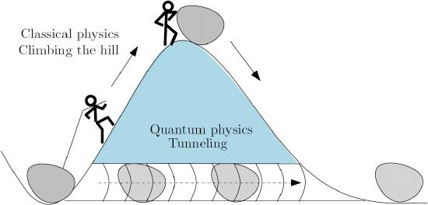
Classical Trajectories, Quantum Dynamic Simulations
A Uniform Dynamic Framework for Electronic and Nuclear Motion
- Moving away from approximating feedback forces between QM and MM regions
Dynamics that preserve detailed balance
(or conserve the Quantum Boltzmann Distribution)
preserve zero-point energy
obtain rates independent of choice of ‘transition state’
Computational efficiency
– employ standard classical molecular dynamics trajectories
Ability to incorporate important quantum effects
- Zero-point energy & Tunneling
Coupled Electron-Nuclear Dynamics
Quantum Coherence effects (electronic and nuclear)
R
TST
P

Slide 4
Methods Used/Developed to Compute Real-time Correlation Functions
Imaginary-time Path Integral based methods for Nonadiabatic Reactions in the condensed phase
Ring Polymer Molecular Dynamics and Mapping-Variable Ring Polymer Molecular Dynamics (RPMD and MV-RPMD)
Exact for equilibrium properties of condensed phase systems
Approximate but inexpensive for condensed phase quantum dynamics
RPMD captures: ZPE and tunneling, no coherence effects. Applicable to one-electron transfer processes.
MV-RPMD captures: ZPE, tunneling, and short-time electronic coherence effects, no nuclear coherence effects.
Applicable to multi-electron, multi-level systems
Real-time Path Integral based methods for Nonadiabatic Dynamics:
Linearized path-integral based methods with mapping variables:
- Inexpensive, accurately describes ZPE, tunneling, and some electronic coherences, but no nuclear coherence effects
Double Herman-Kluk Initial Value Representation (DHK-IVR)
Expensive but accurate, captures most quantum effects including nuclear and electronic quantum coherences
Mixed Quantum-Classical Initial Value Representation (MQC-IVR)
Uniform framework to tune from Linearized to DHK-IVR i.e. classical-limit to quantum-limit semiclassical dynamics.

Slide 5
Methods Used/Developed to Compute Real-time Correlation Functions
Imaginary-time Path Integral based methods for Nonadiabatic Dynamics
Ring Polymer Molecular Dynamics and Mapping-Variable Ring Polymer Molecular Dynamics (RPMD and MV-RPMD)
Exact for equilibrium properties of condensed phase systems
Approximate but inexpensive condensed phase quantum dynamics;
RPMD captures: ZPE and tunneling, no coherence effects. Applicable to one-electron transfer processes.
MV-RPMD captures: ZPE, tunneling, and short-time electronic coherence effects, no nuclear coherence effects.
Applicable to multi-electron, multi-level systems
Real-time Path Integral based methods for Nonadiabatic Reactions in the gas phase/at metal surfaces
Linearized path-integral based methods with mapping variables:
- Inexpensive, accurately describes ZPE, tunneling, and some electronic coherences, but no nuclear coherence effects
Double Herman-Kluk Initial Value Representation (DHK-IVR)
Expensive but accurate, captures most quantum effects including nuclear and electronic quantum coherences
Mixed Quantum-Classical Initial Value Representation (MQC-IVR)
Uniform framework to tune from Linearized to DHK-IVR i.e. classical-limit to quantum-limit semiclassical dynamics.

Slide 6
The Semiclassical Approximation
Focus on the SC Initial Value Representation (SC-IVR) and its many flavors
The Van-Vleck-Gutzwiller (VVG) propagator derived as a stationary phase approximation to Feynman propagator
W. H. Miller, J. Phys. Chem. A (2001)
Path Integral
VVG propagator
q
$$q_{N}$$
SPA
$$q_{N}$$
$$δS=0$$
$$q_{0}$$
$$q_{0}$$
t
$$e^{−\hat{i}Ht/ℏ}∝∫dq_{0}∫dq_{2}…∫dq_{N}\left. |q_{N}\right\rangle e^{\frac{iS\left(q_{0},q_{1},…,q_{N}\right)}{ℏ}}\left\langle q_{0}\right.|$$
$e^{−\hat{i}Ht/ℏ}={\left(2πiℏ\right)}^{−N}\sum_{j=1}^{class. path}{∫dq_{N}∫dq_{0}{\left|\frac{∂q_{N}}{∂p_{0}}\right|}^{−\frac{1}{2}}}e^{iS_{j}\left(q_{N},q_{0}\right)/ℏ}e^{−iπν_{j}/ℏ}$ $\left. |q_{N}\right\rangle \left\langle q_{0}\right.|$
Sum over all possible paths from $q_{0}$ to $q_{N}$ in time ‘t’
Van Vleck, Proc. Natl. Acad. Sci (1928)

Slide 7
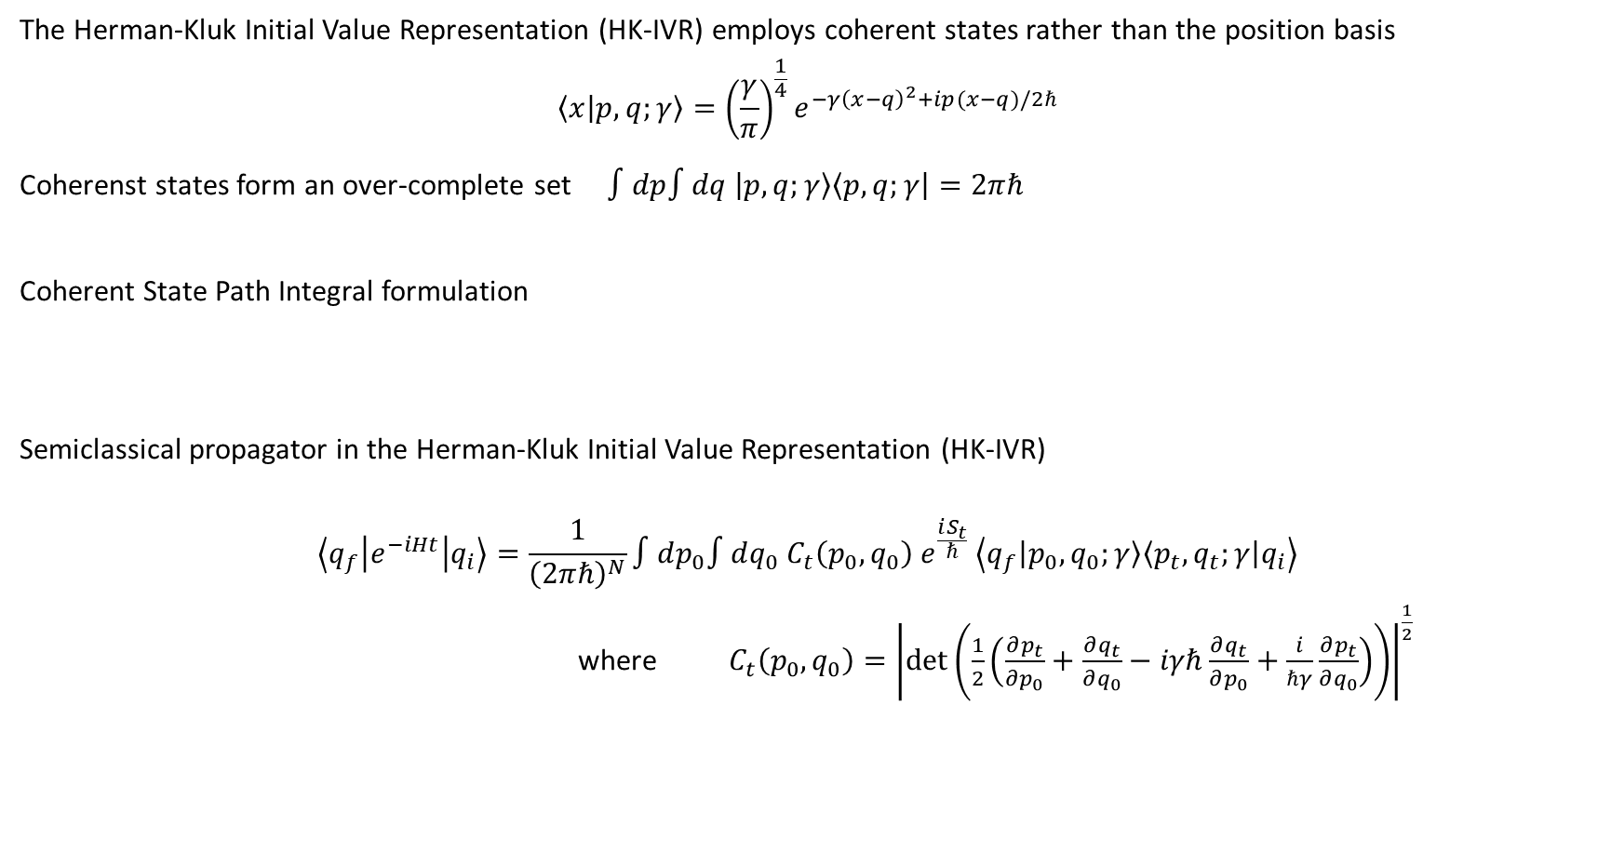
Herman-Kluk Initial Value Representation
The Herman-Kluk Initial Value Representation (HK-IVR) employs coherent states rather than the position basis
$$\left\langle x | p,q;γ\right\rangle ={\left(\frac{γ}{π}\right)}^{\frac{1}{4}}e^{−γ{\left(x−q\right)}^{2}+ip(x−q)/2ℏ}$$
Coherenst states form an over-complete set $∫dp∫dq \left|p,q;γ\right\rangle \left\langle p,q;γ\right|=2πℏ$
Coherent State Path Integral formulation
Semiclassical propagator in the Herman-Kluk Initial Value Representation (HK-IVR)
$$\left\langle q_{f} | e^{−iHt} | q_{i}\right\rangle =\frac{1}{{\left(2πℏ\right)}^{N}}∫dp_{0}∫dq_{0} C_{t}\left(p_{0},q_{0}\right) e^{\frac{iS_{t}}{ℏ}} \left\langle q_{f}\left|p_{0},q_{0};γ\right\rangle \left\langle p_{t}, q_{t};γ\right|q_{i}\right\rangle$$
where $C_{t}\left(p_{0},q_{0}\right)={\left|\det\left(\frac{1}{2}\left(\frac{∂p_{t}}{∂p_{0}}+\frac{∂q_{t}}{∂q_{0}}−iγℏ\frac{∂q_{t}}{∂p_{0}}+\frac{i}{ℏγ}\frac{∂p_{t}}{∂q_{0}}\right)\right)\right|}^{\frac{1}{2}}$
J. R. Klauder, Proceedings of the NATO Advanced Study Institute (1978)
Coherent states provide good sampling function for initial positions and momenta
Monodromy matrices; time evolution requires Hessian
M. F. Herman and E. Kluk, Chem. Phys. 91, 27 (1984)

Slide 8
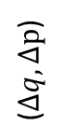
Semiclassical Real-Time Correlation Functions
$$C_{AB}=Tr[\hat{A}e^{iHt/ℏ}\hat{B} e^{−iHt/ℏ}]$$
Double Herman-Kluk (DHK-IVR) Approximation
$$C_{AB}\left(t\right)≈{\left(2πℏ\right)}^{−F}∫dp_{0}∫dq_{0}∫dΔp∫dΔq \left\langle p_{0}q_{0} | \hat{A} | p_{0}^{′}q_{0}^{′}\right\rangle \left\langle p_{t}^{′}q_{t}^{′} | \hat{B} | p_{t}q_{t}\right\rangle C_{HK}\left(p_{0},q_{0},Δp, Δq\right) { e }^{\frac{i}{ℏ} \left(S_{t}+S_{−t}\right)}$$
Double phase space integral
${(q}_{0}, p_{0}$)
${(q}_{t}, p_{t}$)
+t
`Jump’ induced by operator B
$$q_{t}^{′}−q_{t}=Δq$$
$$p_{t}^{′}−p_{t}=Δp$$
$$\hat{A}$$
($Δq, Δp$)
$$\hat{B}$$
-t
${(q′}_{0}, {p′}_{0}$)
${(q′}_{t}, {p′}_{t}$)
See for instance: W. H. Miller, J. Phys. Chem. A (2001)

Slide 9
Semiclassical Real-Time Correlation Functions
$$C_{AB}=Tr[\hat{A}e^{iHt/ℏ}\hat{B} e^{−iHt/ℏ}]$$
Double Herman-Kluk (DHK-IVR) Approximation
$$C_{AB}\left(t\right)≈{\left(2πℏ\right)}^{−F}∫dp_{0}∫dq_{0}∫dΔp∫dΔq \left\langle p_{0}q_{0} | \hat{A} | p_{0}^{′}q_{0}^{′}\right\rangle \left\langle p_{t}^{′}q_{t}^{′} | \hat{B} | p_{t}q_{t}\right\rangle C_{HK}\left(p_{0},q_{0},Δp, Δq\right) { e }^{\frac{i}{ℏ} \left(S_{t}+S_{−t}\right)}$$
Operators and coherent state overlaps
${(q}_{0}, p_{0}$)
${(q}_{t}, p_{t}$)
+t
`Jump’ induced by operator B
$$q_{t}^{′}−q_{t}=Δq$$
$$p_{t}^{′}−p_{t}=Δp$$
$$\hat{A}$$
($Δq, Δp$)
$$\hat{B}$$
-t
${(q′}_{0}, {p′}_{0}$)
${(q′}_{t}, {p′}_{t}$)
See for instance: W. H. Miller, J. Phys. Chem. A (2001)

Slide 10
Semiclassical Real-Time Correlation Functions
$$C_{AB}=Tr[\hat{A}e^{iHt/ℏ}\hat{B} e^{−iHt/ℏ}]$$
Double Herman-Kluk (DHK-IVR) Approximation
$$C_{AB}\left(t\right)≈{\left(2πℏ\right)}^{−F}∫dp_{0}∫dq_{0}∫dΔp∫dΔq \left\langle p_{0}q_{0} | \hat{A} | p_{0}^{′}q_{0}^{′}\right\rangle \left\langle p_{t}^{′}q_{t}^{′} | \hat{B} | p_{t}q_{t}\right\rangle C_{HK}\left(p_{0},q_{0},Δp, Δq\right) { e }^{\frac{i}{ℏ} \left(S_{t}+S_{−t}\right)}$$
Prefactor
${(q}_{0}, p_{0}$)
${(q}_{t}, p_{t}$)
+t
`Jump’ induced by operator B
$$q_{t}^{′}−q_{t}=Δq$$
$$p_{t}^{′}−p_{t}=Δp$$
$$\hat{A}$$
($Δq, Δp$)
$$\hat{B}$$
-t
${(q′}_{0}, {p′}_{0}$)
${(q′}_{t}, {p′}_{t}$)
See for instance: W. H. Miller, J. Phys. Chem. A (2001)

Slide 11
Semiclassical Real-Time Correlation Functions
$$C_{AB}=Tr[\hat{A}e^{iHt/ℏ}\hat{B} e^{−iHt/ℏ}]$$
Double Herman-Kluk (DHK-IVR) Approximation
$$C_{AB}\left(t\right)≈{\left(2πℏ\right)}^{−F}∫dp_{0}∫dq_{0}∫dΔp∫dΔq \left\langle p_{0}q_{0} | \hat{A} | p_{0}^{′}q_{0}^{′}\right\rangle \left\langle p_{t}^{′}q_{t}^{′} | \hat{B} | p_{t}q_{t}\right\rangle C_{HK}\left(p_{0},q_{0},Δp, Δq\right) { e }^{\frac{i}{ℏ} \left(S_{t}+S_{−t}\right)}$$
Action difference
${(q}_{0}, p_{0}$)
${(q}_{t}, p_{t}$)
+t
`Jump’ induced by operator B
$$q_{t}^{′}−q_{t}=Δq$$
$$p_{t}^{′}−p_{t}=Δp$$
$$\hat{A}$$
($Δq, Δp$)
$$\hat{B}$$
-t
${(q′}_{0}, {p′}_{0}$)
${(q′}_{t}, {p′}_{t}$)
See for instance: W. H. Miller, J. Phys. Chem. A (2001)

Slide 12
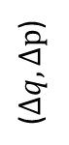
Tuning the Semiclassical Correlation Function
$$C_{AB}\left(t\right)≈{\left(2πℏ\right)}^{−F}∫dp_{0}∫dq_{0}∫dΔp∫dΔq \left\langle p_{0}q_{0} | \hat{A} | p_{0}^{′}q_{0}^{′}\right\rangle \left\langle p_{t}^{′}q_{t}^{′} | \hat{B} | p_{t}q_{t}\right\rangle C_{HK}(p_{0},q_{0},Δp, Δq){ e }^{\frac{i}{ℏ} \left(S_{t}+S_{−t}\right)}$$
${(q}_{0}, p_{0}$)
${(q}_{t}, p_{t}$)
+t
`Jump’ induced by operator B
$$q_{t}^{′}−q_{t}=Δq$$
$$p_{t}^{′}−p_{t}=Δp$$
$$\hat{A}$$
$$\hat{B}$$
($Δq, Δp$)
-t
${(q′}_{0}, {p′}_{0}$)
${(q′}_{t}, {p′}_{t}$)
Linearizing action difference $≈$ $Δp, Δq∈(−δ,δ)$ yields classical-limit methods like LSC or Husimi-IVR
To tune between classical-limit and quantum-limit SC theory: can we control the extent of $Δp, Δq$ for every d.o.f ?
$$C_{AB}\left(t\right)≈∫dp_{0}∫dq_{0} A_{W/H}\left(p_{0},q_{0}\right)B_{W/H}(p_{t}, q_{t})$$
S. V. Antipov, Z. Ye, and N. Ananth, J. Chem. Phys. (2015)

Slide 13
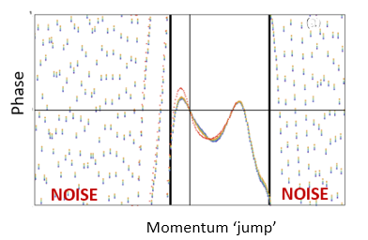
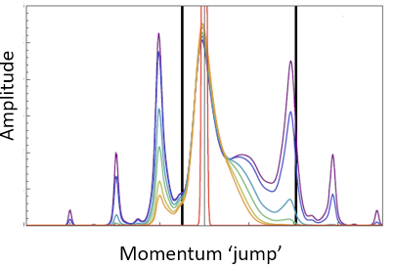
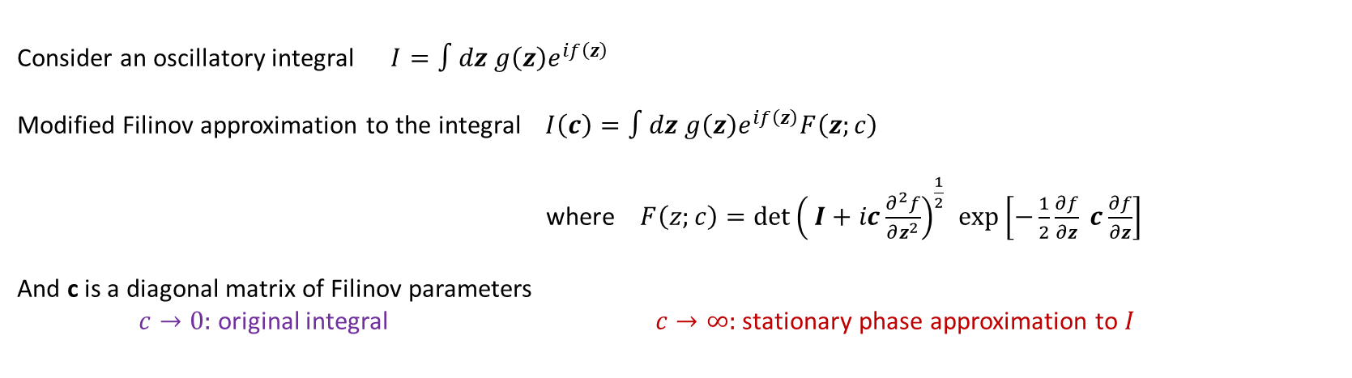
Modified Filinov Filtration
Modified Filinov filtration: previously used to reduce the oscillatory character of DHK-IVR integrand (GFB-IVR)
N. Makri and W. H. Miller, J. Chem. Phys. (1988)
M. Thoss, H. Wang, and W. H. Miller, J. Chem. Phys. (2001)
Consider an oscillatory integral $I=∫dz g\left(z\right)e^{if\left(z\right)}$
Modified Filinov approximation to the integral $I\left(c\right)=∫dz g\left(z\right)e^{if\left(z\right)}F\left(z;c\right)$
where $F\left(z;c\right)={\det\left( I+ic\frac{∂^{2}f}{∂z^{2}}\right)}^{\frac{1}{2} }\exp\left[−\frac{1}{2}\frac{∂f}{∂z} c\frac{∂f}{∂z}\right]$
And c is a diagonal matrix of Filinov parameters
$c→0:$ original integral $c→∞:$ stationary phase approximation to $I$
M. S. Church, S. V. Antipov, and N. Ananth, J. Chem. Phys. (2017)

Slide 14
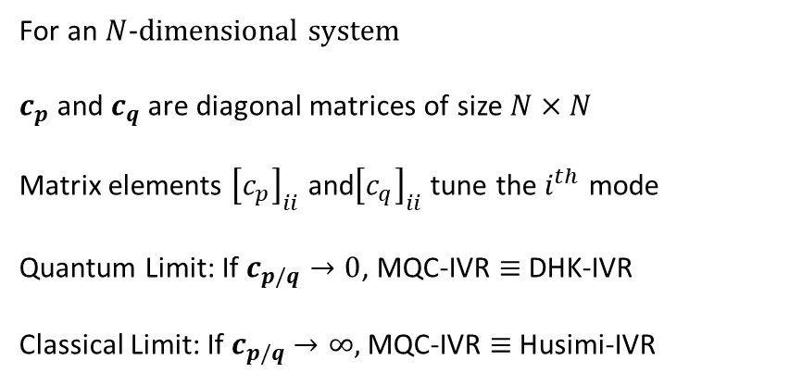
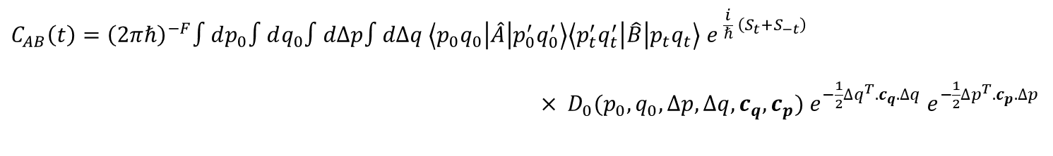
Mixed Quantum Classical (MQC)-IVR
$$C_{AB}\left(t\right)={\left(2πℏ\right)}^{−F}∫dp_{0}∫dq_{0}∫dΔp∫dΔq \left\langle p_{0}q_{0} | \hat{A} | p_{0}^{′}q_{0}^{′}\right\rangle \left\langle p_{t}^{′}q_{t}^{′} | \hat{B} | p_{t}q_{t}\right\rangle { e }^{\frac{i}{ℏ} \left(S_{t}+S_{−t}\right)}$$
$× D_{0}(p_{0},q_{0},Δp,Δq, c_{q}, c_{p}) e^{−\frac{1}{2}Δq^{T}.c_{q}.Δq}{ e}^{−\frac{1}{2}Δp^{T}.c_{p}.Δp}$
${(q}_{0}, p_{0}$)
${(q}_{t}, p_{t}$)
For an $N$-dimensional system
$c_{p}$ and $c_{q}$ are diagonal matrices of size $N×N$
Matrix elements ${\left[c_{p}\right]}_{ii}$ and${\left[c_{q}\right]}_{ii}$ tune the $i^{th}$ mode
Quantum Limit: If $c_{p/q}→0$, MQC-IVR $≡$ DHK-IVR
Classical Limit: If $c_{p/q}$ $→∞,$ MQC-IVR $≡$ Husimi-IVR
+t
$$\hat{A}$$
$$\hat{B}$$
-t
${(q′}_{0}, {p′}_{0}$)
${(q′}_{t}, {p′}_{t}$)
S. V. Antipov, Z. Ye, and N. Ananth, J. Chem. Phys. (2015)

Slide 15
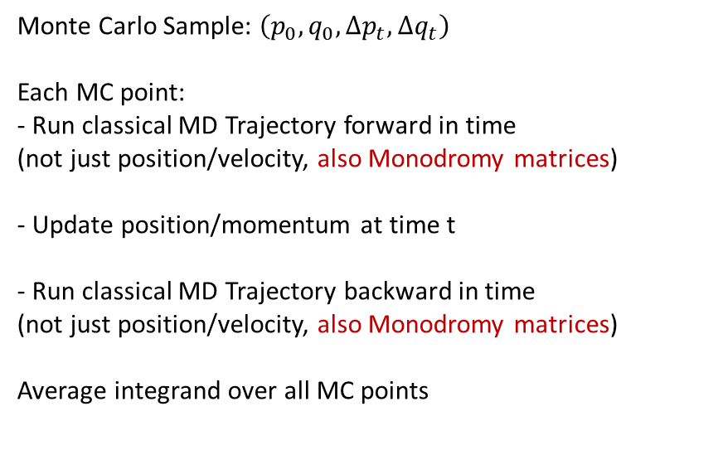
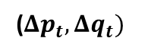
Calculation Outline
$$C_{AB}\left(t\right)={\left(2πℏ\right)}^{−F}∫dp_{0}∫dq_{0}∫dΔp∫dΔq \left\langle p_{0}q_{0} | \hat{A} | p_{0}^{′}q_{0}^{′}\right\rangle \left\langle p_{t}^{′}q_{t}^{′} | \hat{B} | p_{t}q_{t}\right\rangle { e }^{\frac{i}{ℏ} \left(S_{t}+S_{−t}\right)}$$
$× D_{0}(p_{0},q_{0},Δp,Δq, c_{q}, c_{p}) e^{−\frac{1}{2}Δq^{T}.c_{q}.Δq}{ e}^{−\frac{1}{2}Δp^{T}.c_{p}.Δp}$
${(q}_{0}, p_{0}$)
${(q}_{t}, p_{t}$)
Monte Carlo Sample: $\left(p_{0},q_{0},Δp_{t},Δq_{t}\right)$
Each MC point:
- Run classical MD Trajectory forward in time
(not just position/velocity, also Monodromy matrices)
- Update position/momentum at time t
- Run classical MD Trajectory backward in time
(not just position/velocity, also Monodromy matrices)
Average integrand over all MC points
+t
$$\hat{A}$$
($Δp_{t}, Δq_{t})$
$$\hat{B}$$
-t
${(q′}_{0}, {p′}_{0}$)
${(q′}_{t}, {p′}_{t}$)
S. V. Antipov, Z. Ye, and N. Ananth, J. Chem. Phys. (2015)

Slide 16
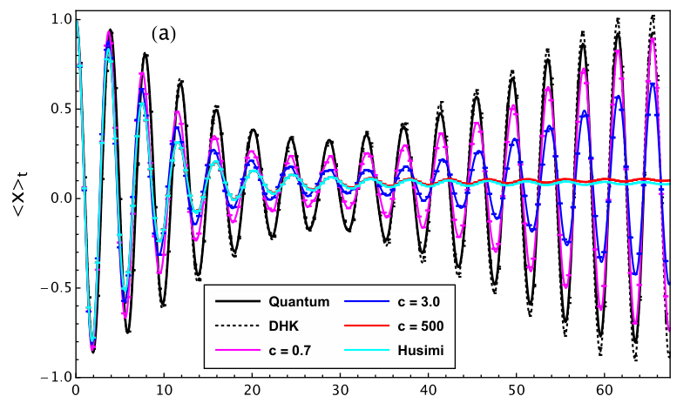
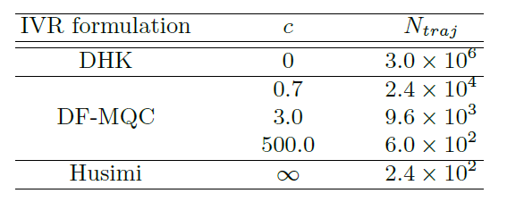
MQC-IVR Results: 1D Model System
1-D Anharmonic Oscillator $V\left(x\right)=0.5x^{2}−0.1x^{3}+0.1x^{4}$
$\hat{A}=|ψ_{i}⟩⟨ψ_{i}|$ (Initial coherent state) and $\hat{B}=\hat{x}$
$${\left\langle x\right\rangle }_{t}$$
MQC
t
S. V. Antipov, Z. Ye, and N. Ananth, J. Chem. Phys. (2015)

Slide 17
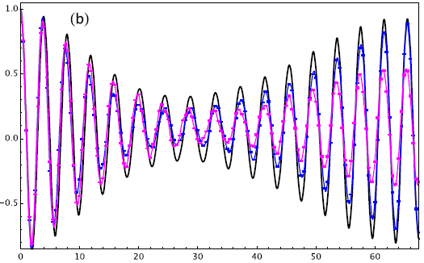
A more efficient MQC-IVR implementation: Double-Forward
Forward-Backward (FB) Double-Forward (DF)
${(q}_{0}, p_{0}$)
${(q}_{t}, p_{t}$)
${(q}_{0}, p_{0}$)
${(q}_{t}, p_{t}$)
+t
+t
$$\hat{A}$$
$$\hat{B}$$
($Δp_{t}, Δq_{t})$
($Δp_{0}, Δq_{0})$
$$\hat{A}$$
$$\hat{B}$$
-t
-t
${(q′}_{0}, {p′}_{0}$)
${(q′}_{t}, {p′}_{t}$)
${(q′}_{0}, {p′}_{0}$)
${(q′}_{t}, {p′}_{t}$)
$c=0.7$ – captures more oscillatory structure
Calculation time: FB = 20hrs DF = 20min
Scaling with number of time points $N_{t}$
FB Implementation: $\frac{1}{2}\left(N_{t}^{2}+3N_{t}\right)$
DF Implementation: $2N_{t}$
$${\left\langle x\right\rangle }_{t}$$
t
M. S. Church, S. V. Antipov, and N. Ananth, J. Chem. Phys. (2017)

Slide 18
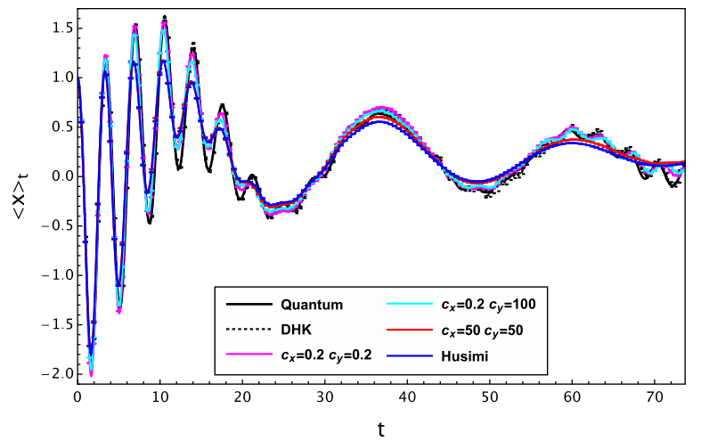
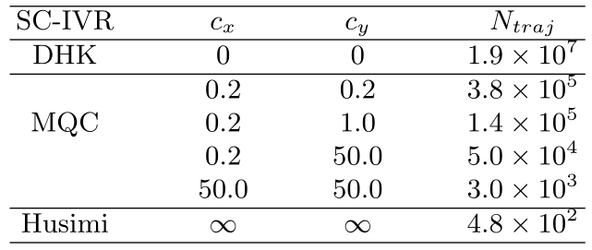
Mixed Limit Semiclassical Simulation : 2D Model System
1D anharmonic oscillator(x) linearly coupled to heavy harmonic mode (y)
$\hat{A}=|ψ_{i}⟩⟨ψ_{i}|$ (Initial coherent state) and $\hat{B}=\hat{x}$
Two parameters: c_{x} = c_{px} and c_{y} = c_{py}
$${\left\langle x\right\rangle }_{t}$$
Mode quantization determined by $\hat{B}$ (Observer)
M. S. Church, S. V. Antipov, and N. Ananth, J. Chem. Phys. (2017)

Slide 19
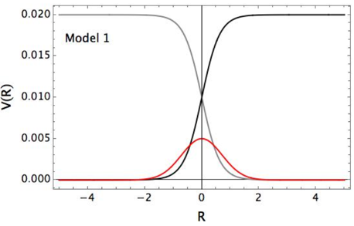
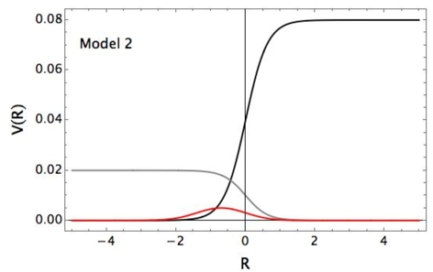
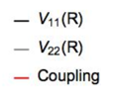
Nonadiabatic Dynamics with MQC-IVR
Map discrete electronic states to Cartesian coordinates
$$H=h_{0}\left(R,P\right)+ \sum_{n,m=1}^{N}{V_{nm}\left(R\right)\left|ψ_{n}\right\rangle \left\langle ψ_{m}\right|} H=h_{0}\left(R,P\right)+\frac{1}{2}\sum_{n,m=1}^{N}{V_{nm}\left(R\right)(x_{n}x_{m}+p_{n}p_{m}−δ_{nm})}$$
H. D. Meyer and W. H. Miller, J. Chem. Phys. (1979)
Compute the correlation function: $\hat{A}=|ψ_{i}〉〈ψ_{i}|$ and $\hat{B}=δ(P_{f}−\hat{P})$

Slide 20
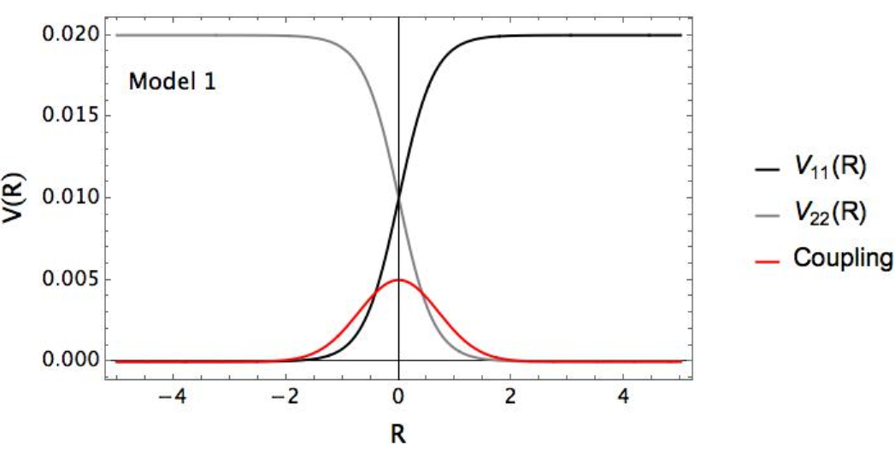
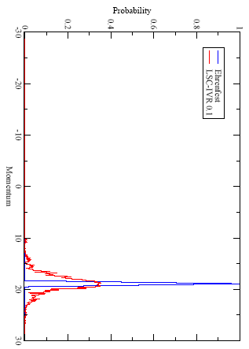
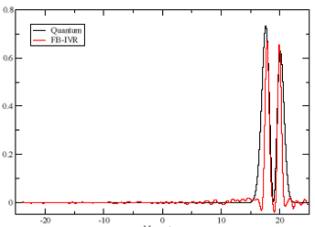
Quantum-Limit and Classical-Limit Semiclassical Results
LSC-IVR
N trajectories $\sim {10}^{4}$
Probability
FB-IVR
N trajectories $\sim {10}^{8}$
Probability
Nuclear Momentum
Nuclear Momentum
N. Ananth, C. Venkataraman, and W. H. Miller, J. Chem. Phys. (2007)

Slide 21
A Symplectic Integration Scheme
“Kinetic” and potential terms are not separable in the MM Hamiltonian
$$H=h_{0}\left(R,P\right)+\frac{1}{2}\sum_{n,m=1}^{N}{V_{nm}\left(R\right)(x_{n}x_{m}+p_{n}p_{m}−δ_{nm})}$$
Step 1: Split $H=H_{1}+H_{2}$ where $H_{1}=\frac{P^{2}}{2M}$ and $H_{2}=$ $\frac{1}{2}\sum_{n,m=1}^{N}{V_{nm}\left(R\right)(x_{n}x_{m}+p_{n}p_{m}−δ_{nm})}$
Step 2: Exactly evolve under $H_{1}$ and $H_{2}$ → obtain approximate evolution under $H$ that is exactly symplectic
Step 3: Check symplecticity of individual steps $M_{H_{1}}^{T} J M_{H_{1}}=J$ and $M_{H_{2}}^{T} J M_{H_{2}}=J$
where matrix $J=\left(\begin{matrix}𝕆 & 𝕀 \\ −𝕀 & 𝕆\end{matrix}\right)$ and the monodromy matrices are $M=\frac{∂z_{t}}{∂z_{0}}$ with $z=\{R,x,P,p\}$
The MInt algorithm is a 2nd order symplectic integrator with flow map: $ψ_{H,Δt}=Φ_{H_{1},Δt/2} . Φ_{H_{1},Δt/2} .Φ_{H_{1},Δt/2}$
M. S. Church, T. J. H. Hele, G. S. Ezra, and N. Ananth, J. Chem. Phys. (2018)

Slide 22
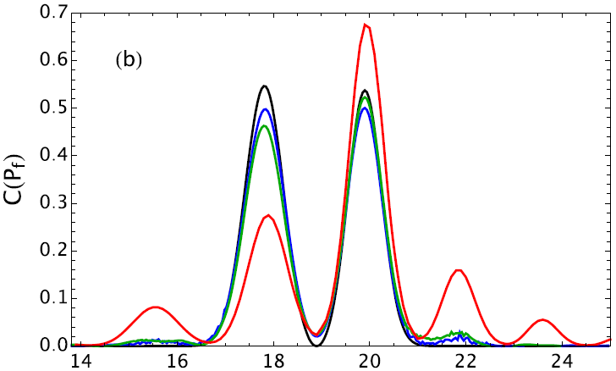
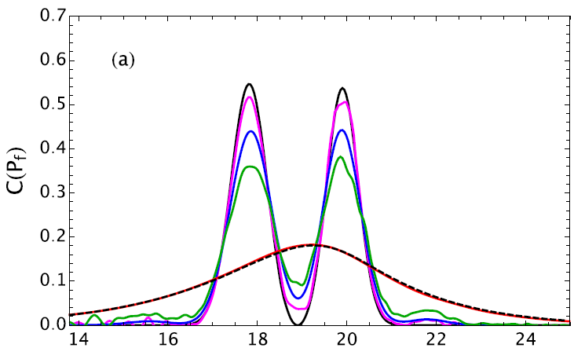
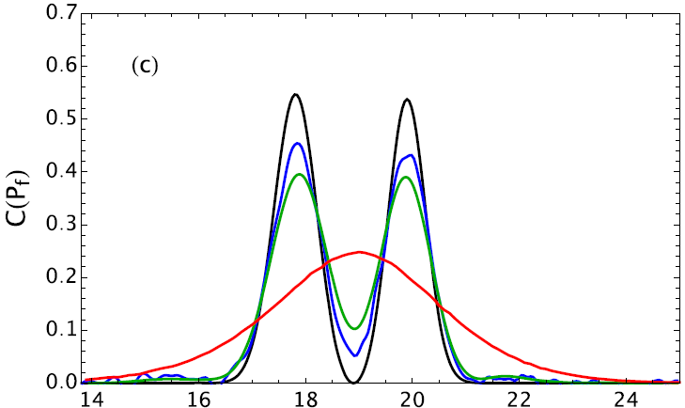
MQC-IVR Results
Model 1: Initial energy = 0.1 a.u.
Exact
$$c_{e}=0.05$$
$$c_{e}=0.1$$
$$c_{e}=10$$
$$c_{n}=0.01$$
Exact
$$c=0.01$$
$$c=0.05$$
$$c=0.1$$
$$c=10$$
Husimi
Exact
$$c_{n}=0.05$$
$$c_{n}=0.1$$
$$c_{n}=10$$
$$c_{e}=c_{n}=c$$
$$c_{e}=0.01$$
M. S. Church, T. J. H. Hele, G. S. Ezra, and N. Ananth, J. Chem. Phys. (2018)

Slide 23
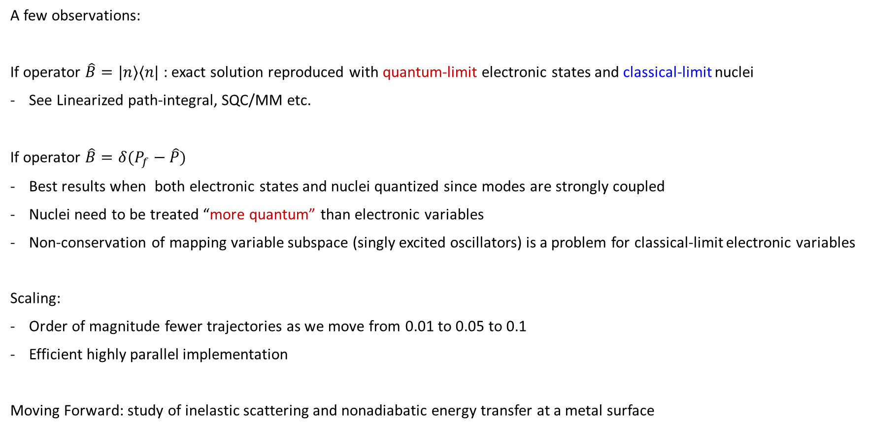
MQC-IVR for Nonadiabatic Systems
A few observations:
If operator $\hat{B}=|n⟩⟨n|$ : exact solution reproduced with quantum-limit electronic states and classical-limit nuclei
See Linearized path-integral, SQC/MM etc.
If operator $\hat{B}=δ(P_{f}−\hat{P})$
Best results when both electronic states and nuclei quantized since modes are strongly coupled
Nuclei need to be treated “more quantum” than electronic variables
Non-conservation of mapping variable subspace (singly excited oscillators) is a problem for classical-limit electronic variables
Scaling:
Order of magnitude fewer trajectories as we move from 0.01 to 0.05 to 0.1
Efficient highly parallel implementation
Moving Forward: study of inelastic scattering and nonadiabatic energy transfer at a metal surface

Slide 24
Software: The good and The Bad
Algorithm:
Monte Carlo sampling for initial conditions (typically a coherent state overlap)
MD simulation with classical Hamiltonian: time evolve positions and momenta, calculation action along path
In addition: for anything beyond LSC, time evolve Monodromy Matrices (require Hessian)
Software (SC-CORR on github)
Modular: can be easily interfaced with on-the-fly ab-initio potential/gradients
MC sampling currently single processor
MD massively parallel within the double-forward implementation
Prefactor: current implementation includes Maslov tracking for the prefactor (working towards more efficient form)
Extension to atomistic system simulations underway
Interface with existing MD code (GROMACS? LAMMPS? DL-POLY?..)
Derived analytic formulation of the mixed limit (few quantum modes, many classical modes)
“Machine learning” (extrapolation) from classical/less-quantum limit to quantum limit (Filinov parameter=0)

Slide 25
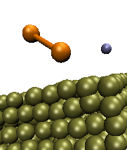
Status of Software: SC-Corr
Summary
$$ν_{NO}$$
e⁻
MQC-IVC circumvents the SC sign problem
Efficient implementation, significant improvements in trajectory convergence
Extrapolation from classical-limit SC to quantum-limit SC dynamics very promising
Immediate application: vibrational state-to-state scattering
Systematic approach to error quantification
Cs
Au
Open Source Software created to calculate Semiclassical Correlation Functions
Code written in Fortran 90, modular structure. Comes with Documentation!
Download: https://github.com/AnanthGroup/SC-IVR-Code-Package
Includes: DHK-IVR(Quantum-Limit semiclassical), LSC-IVR (Classical-limit), MQC-IVR (both forward-backward and double-forward implementation schemes)
Not Public Yet: Python scripts to post-process data
Would Like:
Interface with ab-initio code (for on-the-fly?) : challenge to generate diabats/couplings efficiently
Ability to compare accuracy and efficiency with other methods: Surface Hopping, MQCL, PLDM, wavepacket dynamics..

Slide 26
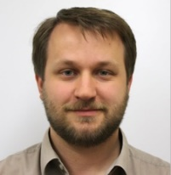

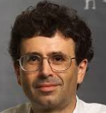

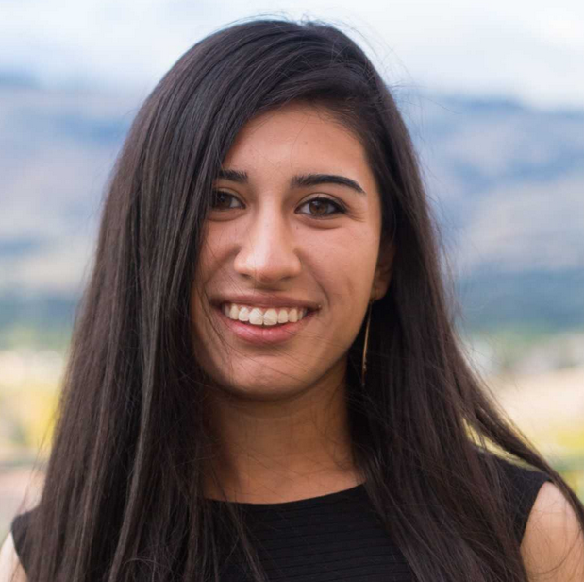
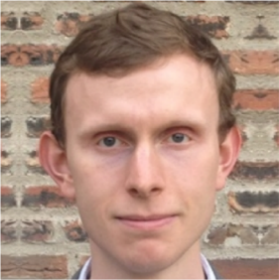








Acknowledgements
Sergey Antipov
(Vanicek group, EPFL)
Matt Church
Tim Hele
(Cavendish Lab, Cambridge)
Eric Fuemmeler
Rachel Kenion
Ziyu Ye
(PhD candidate at U. Penn)
Nadia Palte
Prof. Greg Ezra
(Cornell University)
Funding

Slide 27
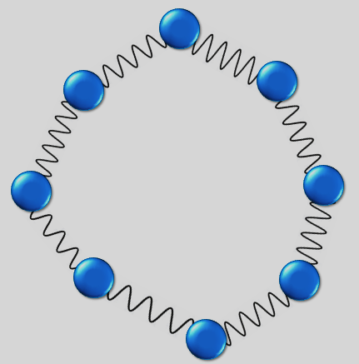
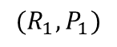
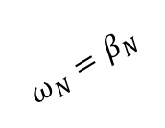
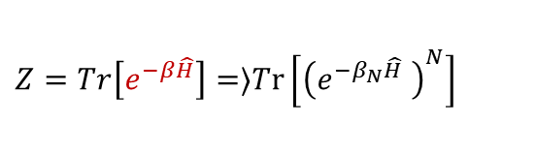
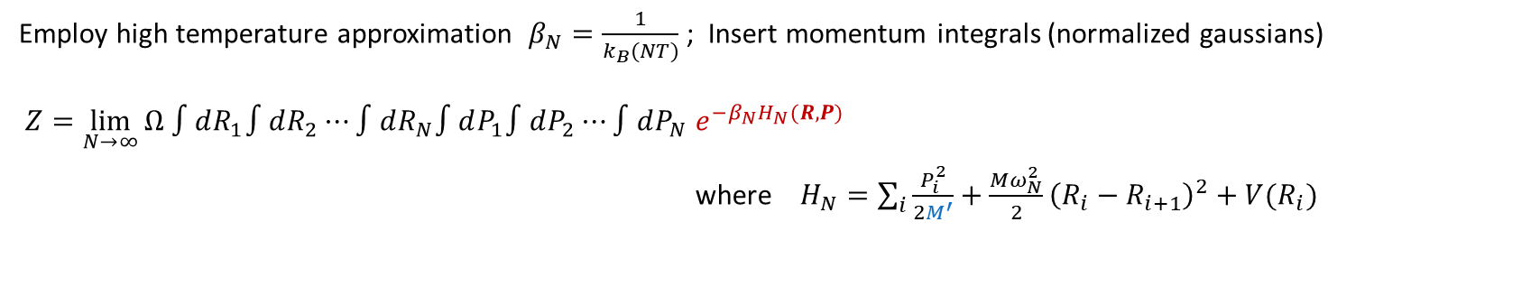
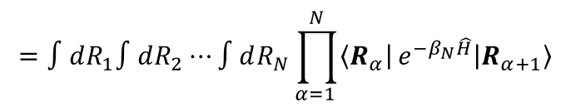
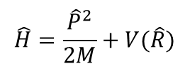
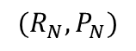
Path Integrals For Equilibrium
$$\hat{H}=\frac{{\hat{P}}^{2}}{2M}+V(\hat{R})$$
$$(R_{N}, P_{N})$$
$${ω_{N}=β}_{N}$$
$$(R_{1}, P_{1})$$
Quantum Statistics
Classical Statistics
R. P. Feynman
$1=∫dR\left|R\right\rangle \left\langle R\right|$ Insert multiple copies of the identity operator
$$Z=Tr\left[e^{−β\hat{H}}\right]=⟩Tr\left[{\left(e^{−β_{N}\hat{H}} \right)}^{N}\right]$$
$$=∫dR_{1}∫dR_{2}⋯∫dR_{N}\prod_{α=1 }^{N}{\left\langle R_{α}\right|}e^{−β_{N}\hat{H}}\left|R_{α+1}\right\rangle$$
Employ high temperature approximation $β_{N}=\frac{1}{k_{B}(NT)}$ ; Insert momentum integrals (normalized gaussians)
$$Z=\lim_{N→∞}{Ω ∫dR_{1}∫dR_{2}⋯∫dR_{N}∫dP_{1}∫dP_{2}⋯∫dP_{N} e^{−β_{N}H_{N}(R,P)} }$$
where $H_{N}=\sum_{i}{\frac{P_{i}^{2}}{2M^{′}}}+\frac{Mω_{N}^{2}}{2}{\left(R_{i}−R_{i+1}\right)}^{2}+V(R_{i})$

Slide 28
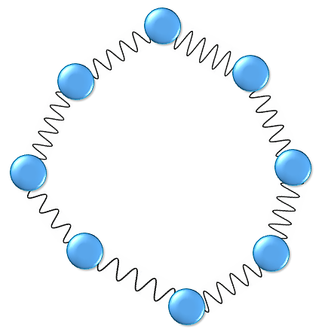
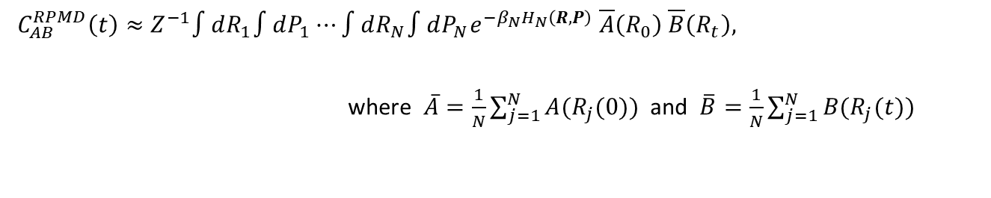
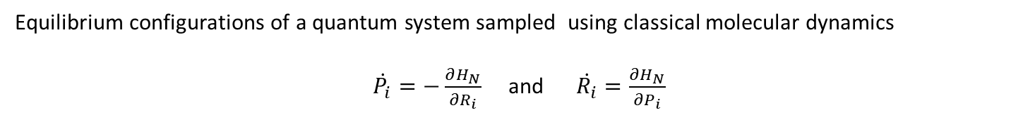
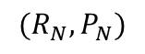
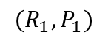
Path Integral Molecular Dynamics
Equilibrium configurations of a quantum system sampled using classical molecular dynamics
$\dot{P_{i}}=−\frac{∂H_{N}}{∂R_{i}}$ and $\dot{R_{i}}=\frac{∂H_{N}}{∂P_{i}}$
$${ω_{N}=β}_{N}$$
$$(R_{N}, P_{N})$$
Parrinello and Rahman, J. Chem. Phys. (1984)
$$(R_{1}, P_{1})$$
Ring Polymer Molecular Dynamics
Can we obtain approximate quantum dynamics from the classical time evolution of the Ring Polymer?
Choose $M^{′}=M$
$$C_{AB}^{RPMD}\left(t\right)≈Z^{−1}∫dR_{1}∫dP_{1}⋯∫dR_{N}∫dP_{N}e^{−β_{N}H_{N}\left(R,P\right)} \overline{A}\left(R_{0}\right) \overline{B}\left(R_{t}\right),$$
where $\overline{A}=\frac{1}{N}\sum_{j=1}^{N}{A(R_{j}(0))}$ and $\overline{B}=\frac{1}{N}\sum_{j=1}^{N}{B(R_{j}(t))}$
D. E. Manolopoulos, S. Althorpe, T. F. Miller III, S. Habershon, T. E. Markland, …
Related Methods:
Centroid Molecular Dynamics G. A. Voth, J. Cao, S. Jang, ...
Linearized W. H. Miller, N. Makri, E. Geva, X.Sun, H. Wang, ...

Slide 29



The Cobalt Hexammine Self-Exchange Reaction: An RPMD Application
$$Co{\left(NH_{3}\right)}_{6}^{2+}+Co{\left(NH_{3}\right)}_{6}^{3+}→Co{\left(NH_{3}\right)}_{6}^{3+}+Co{\left(NH_{3}\right)}_{6}^{2+}$$
2 complexes, 430 SPC water molecules, 1024 bead ring polymer for transferring electron
Force Field Parameters: CHARMM22, Co - Co distance fixed at $7A^{o}$
Each RP electron bead
interacts electrostatically with solvent/complex atom
has a harmonic bond with two neighbor beads
Reaction coordinate: “bead count” – count number of RP beads on donor vs acceptor complex
Software: Implemented in DL-POLY (and now GROMACS)
R. L. Kenion and N. Ananth, Phys. Chem. Chem. Phys. (2016)

Slide 30


Outer Sphere (Solvent) Free Energy Barrier
Brunschwig and Sutin, Coord. Chem. Rev. (1999)
Assume separability of inner and outer sphere free energy barriers
No re-parameterization of force field as the electron transfer reaction progresses
Path Integral Molecular Dynamics (PIMD): Free energy barrier along the ET reaction coordinate
Reactant State configuration
Transition State configuration
F(fb) kcal/mol
R. L. Kenion and N. Ananth, Phys. Chem. Chem. Phys. (2016)

Slide 31



Reaction Rate
Inner sphere reorganization energy from DFT = 7.8-9.7 kcal/mol
$$E_{z}\left(r_{z+1}\right)−E_{z}(r_{z})+E_{z+1}\left(r_{z}\right)−E_{z+1}(r_{z+1})$$
Transition State Theory Rate: combine inner and outer sphere barrier values.
$$k_{TST}={\left(\frac{1}{2πβ}\right)}^{−\frac{1}{2} }\frac{e^{−βΔ{F(ξ}^{\#}) }}{\int_{0}^{ξ^{∗}}{e^{−βΔF\left(ξ\right)}}dξ}$$
Endres, LaBute and Cox, J. Chem. Phys. (2003)
Reaction Rate Theory: $k=k_{TST}×\lim_{t→∞}{κ(t)}$
Ring Polymer Molecular Dynamics Rate: accounts for dynamic recrossing of the TST barrier
$$r^{\#}$$

Slide 32




Reaction Rate
$k_{RPMD}=K_{bi}×\lim_{t→∞}{κ\left(t\right)} k_{TST}$ $=0.9×{10}^{−8}−2×{10}^{−7} M^{−1}s^{−1}$
$k_{expt}≈{10}^{−7} M^{−1}s^{−1}$
R. L. Kenion and N. Ananth, Phys. Chem. Chem. Phys. (2016)
$$\lim_{t→∞}{κ\left(t\right)}=0.64$$
Hammershoi, Geselowitz, Taube, Inorg. Chem. (1984)
Rachel Kenion

Slide 33



RPMD Limitations
Electron Transfer Models: Exploring Marcus Regimes
Moving Forward:
Free Energy
RPMD
MT
Solvent Coordinate
A. R. Menzeleev, N. Ananth, T. F. Miller, III, J. Chem. Phys. (2010)
Dynamics that preserve detailed balance
Uniform Dynamic Framework
Multi-electron systems and the inverted regime
Incorporate tunneling and zero-point energy
Simulating excited electronic state dynamics
Linear scaling with system size

Slide 34

Electronic Variable Path Integral
$$Z=\lim_{N→∞ }Φ\int{d\left\{R_{α},P_{α}\right\} e^{−β_{N}H_{R}(R_{α},P_{α})}}\sum_{\left\{n_{α}\right\}=1}^{D}{\prod_{α=1}^{N}{ \left\langle n_{α} | e^{−\frac{β}{N}\hat{V}(R_{α},R_{α+1})} | n_{α+1}\right\rangle }}$$
Identifying the Identity :
All space Mapping subspace
Position space: $\hat{I}=∫dx \left|\left.x\right\rangle \left\langle x\right.\right|$ SEO subspace: $\hat{I}=\sum_{n}{\left|n\right\rangle \left\langle n\right|= {\hat{Ρ}}_{SEO}}$
Oscillator space: $\hat{I}=\prod_{i=1}^{D}{\sum_{j_{i}=0}^{∞}{|\left.j_{i}\right\rangle }={\hat{Ρ}}_{SEO}+{\hat{Ρ}}_{other}}$ Position subspace: $\hat{I}=∫dx \left|\left.x\right\rangle \left\langle x\right.\right|{\hat{Ρ}}_{SEO}$
Constructing the Mapping Variable RPMD Hamiltonian:
Insert identity N times
Wigner transform to represent electronic trace in mapping phase-space
$Tr\left[\hat{O}\right]=∫dx∫dp O(x,p)$ where $O\left(x,p\right)=\frac{1}{{\left(2πℏ\right)}^{D}}∫dΔx \left\langle x−\frac{Δx}{2} | {\hat{Ρ}}_{SEO}\hat{O}{\hat{Ρ}}_{SEO} | x+\frac{Δx}{2}\right\rangle e^{ip^{T}.Δx}$
N. Ananth and T. F. Miller III, J. Chem. Phys. 2010
N. Ananth, J. Chem. Phys. 2013

Slide 35






Mapping Variable PIMD: An Exact Mapping at Equilibrium
$$\hat{H}=\frac{{\hat{P}}^{2}}{2M}+V(\hat{R})$$
$${\{R}_{i},P_{i}\}$$
$${\{x}_{i}, p_{i}\}$$
Quantum Statistics
Classical Statistics
N. Ananth, J. Chem. Phys. (2013)
$$Z=\lim_{N→∞}F∫d{\{x}_{α}\}∫d{\{R}_{α}\}∫d{\{p}_{α}\}∫d{\{P}_{α}\}e^{−β_{N}H_{MV}}sgn\left(Γ\right)$$
$H_{MV}=\sum_{α}{\frac{P_{α}^{T}.P_{α}}{2M}+ \frac{MN^{2}}{2β^{2}ℏ^{2}}{\left(R_{α}−R_{α+1}\right)}^{T}.\left(R_{α}−R_{α+1}\right)+V_{0}(R_{α})+\frac{N}{β}\left(x_{α}^{T}. x_{α}+p_{α}^{T}. p_{α}\right)−\frac{N}{β}ln⁡|Γ|}$
$$Γ=Re\left[\prod_{α=1}^{P}{{(C}_{α}−\frac{1}{2}1) M\left(R_{α}\right)}\right]$$
$$M_{nm}\left(R_{α}\right)=\left\{\begin{aligned}e^{−β_{N}V_{nn}(R_{α})}, n=m \\ {−β_{N}V_{nm}(R_{α})e}^{−β_{N}V_{nn}(R_{α})}, n≠m\end{aligned}\right.$$
$$C_{α}=\left(x_{α}+ip_{α}\right)⨂{\left(x_{α}−ip_{α}\right)}^{T}$$

Slide 36





MV-RPMD
$H_{MV}=\sum_{α}{\frac{P_{α}^{T}.P_{α}}{2M}+ \frac{MN^{2}}{2β^{2}ℏ^{2}}{\left(R_{α}−R_{α+1}\right)}^{T}.\left(R_{α}−R_{α+1}\right)+V_{0}(R_{α})+\frac{N}{β}\left(x_{α}^{T}. x_{α}+p_{α}^{T}. p_{α}\right)−\frac{N}{β}ln⁡|Γ|}$
$$\dot{R_{i}}=\frac{∂H_{MV}}{∂P_{i}}$$
$$\dot{P_{i}}=−\frac{∂H_{MV}}{∂R_{i}}$$
Equations of Motion for Nuclear variables
Equations of Motion for n^{th} Electronic state variables
$${\dot{x_{i}}}^{(n)}=\frac{∂H_{MV}}{∂p_{i}^{(n)}}$$
$${\dot{p_{i}}}^{(n)}=−\frac{∂H_{MV}}{∂x_{i}^{(n)}}$$
Real-time correlation function
Alternate Strategies:
Combine MV-PIMD initial conditions with Semiclassical dynamics – but dynamics do not obey detailed balance
$$C_{AB}^{MV}\left(t\right)=Z^{−1}∫dy_{1}⋯∫dy_{N} e^{−β_{N}H_{MV}\left(y\right)} \overline{A}\left(y_{0}\right) \overline{B}\left(y_{t}\right)sgn(Γ)$$
$$y=\{x,p,R,P\}$$
N. Ananth, J. Chem. Phys. (2013)
J. O. Richardson and M. Thoss, J. Chem. Phys. Comm. (2012); S. N. Chowdhury and P. Huo, J. Chem. Phys. (2017)

Slide 37







Electron Transfer Model: Position Auto-Correlation Function
$$V_{11}\left(R\right)=−R+\frac{1}{2}R^{2}$$
$$V_{22}\left(R\right)=R+\frac{1}{2}R^{2}$$
V(R)
$$V_{12}=Δ$$
R
Strong coupling
$$βV_{12}=10$$
Moderate coupling
$$βV_{12}=1$$
Weak coupling
$$βV_{12}=0.1$$
Exact –
MF-RPMD –
MV-RPMD –
C_{RR}(t)
N=10
N=5
N=4
t (a.u.)
N. Ananth, J. Chem. Phys. (2013)

Slide 38






MV-RPMD Application: Ultrafast Photo-induced Dissociation
V(R)
R (a.u.) R (a.u.) R (a.u.)
E. Coronado, J. Xing, and W. H. Miller, Chem. Phys. Lett. (2001)
Potential Energy Surfaces
$$V_{i}=De_{i}{\left(1−e^{−β_{i}\left(R−Re_{i}\right)}\right)}^{2}+c_{i}$$
Coupling between surfaces:
$$V_{ij}=A_{ij}e^{−a_{ij}{\left(R−R_{ij}\right)}^{2} }$$
Deriving Excited State Population Estimators
$$P_{n}=\frac{1}{2N}\sum_{α}{({\left[x_{α}\right]}_{n}^{2}{+\left[p_{α}\right]}_{n}^{2}−1)}$$
J. R. Duke and N. Ananth, J. Phys. Chem. Lett. (2015); T. J. H. Hele and N. Ananth, Farad. Discuss. (2016)

Slide 39



MV-RPMD: Excited State Dynamics in the Gas Phase
Potential Energy
Electronic State Populatiotns
Electronic State Populatiotns
Nuclear Position
LSC-IVR
Exact
t (a.u.)
MV-RPMD
Exact
t (a.u.)
J. R. Duke and N. Ananth, J. Phys. Chem. Lett. (2015).

Slide 40





MV-RPMD Applications
Gas phase scattering models (Tully) exploring different regimes of coupled electron-nuclear dynamics
Potential Energy
State Populations
Nuclear Position
t (a.u.)
t (a.u.)
t (a.u.)
(9
Duke and Ananth, J. Phys. Chem. Lett. (2015)
Condensed Phase Proton Coupled Electron Transfer (PCET):
Reactant
4 Electron/Proton States
Collective Solvent
Thermal bath (24 modes)
Product
$$⟨P^{\#}\left(0\right)P_{n}\left(t\right)⟩$$
ET only
PT only
S. Pierre, J. R. Duke, T. J. H. Hele, and N. Ananth, J. Chem. Phys. (2017)
t (a.u.)

Slide 41
Software for RPMD and MV-RPMD
Implementation:
Sample initial distribution using PIMD or PIMC (Canonical Ensemble)
Real-time NVE trajectories from initial points to calculate RPMD/MV-RPMD correlation functions
Software Modifications:
Include RP/MV-RP as ‘molecule’ (non-trivial given current MD software structure)
Allow mixed time-slicing i.e. some particles are quantum and others are classical i.e. 1-bead limit
Implement efficient integration scheme for the RP spring terms (eliminate need for small MD time step)
Would Like:
1. Interface with electronic structure software for energies/gradients that is (ideally)
- accurate for excited states
- includes an efficient scheme for diabatization/quasi-diabatization
2. Code for comparable methods (Linearized path integrals, some Generalized Quantum Master Equation methods)
T. F. Miller III, J. Chem. Phys. (2008)
R. P. Steele, J. Zwickl, J. C. Tully, J. Chem. Phys (2011)
M. Cerriotti, M. Parrinello, T. E. Markland, and D. E. Manolopoulos, J. Chem. Phys (2010)

Slide 42




Acknowledgements
Jessica Duke
(Data Analyst, RAND corp.)
Rachel Kenion
Sadrach Pierre
Tim Hele
(Cavendish Lab, Cambridge)
Elliot Eklund
Adam Rettig
(PhD candidate at UC Berkeley)
Funding

Slide 43
On the effectiveness of Filinov Filtration
M. Spanner, V. S. Batista, and P. Brumer, J. Chem. Phys. (2005)
Filinov filtration ineffective for wavepacket propagation
Examine the amplitude (A) and phase ($φ$) of the MQC-IVR integrand for a single trajectory
Use different Filinov parameter values: purple = quantum-limit red = classical-limit
As Filinov parameter $→∞$
Phase unchanged Amplitude $→0$ in regions of highly oscillatory phase
M. S. Church, S. V. Antipov, and N. Ananth, J. Chem. Phys. (2017)

Slide 44

On The Effectiveness of Filinov Filtration
Examine average amplitude (A) and phase ($φ$) for c=0 case (DHK-IVR)
Increase the number of trajectories to 10⁶
gray 10³ – red 10⁴ – blue 10⁶
Amplitude in oscillatory phase regions $→$ 0 as we approach 10⁶ trajectories
In MQC-IVR, we filter amplitude using Filinov parameters:
envelope for amplitude with c=0.7 shown in green
NOISE
NOISE
$<Amplitude>$ $<Phase>$
Momentum ‘jump’
M. S. Church, S. V. Antipov, and N. Ananth, J. Chem. Phys. (2017)

